Slide 1
Towards Graphical configuration inside the into-cps application
Christian Møldrup Legaard
Casper Thule
Peter Gorm Larsen

Slide 2
Agenda
Background
Contribution and Demo
Future Work
Questions

Slide 3
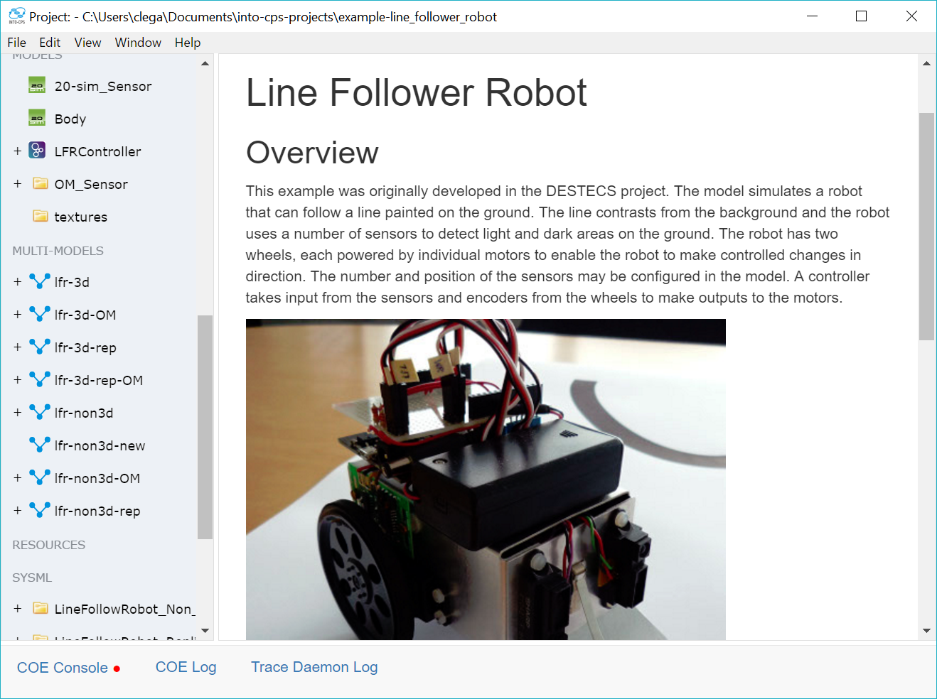
Background – motivation
System Engineering Course
Powerful tooling
Frustrating User interface

Slide 4
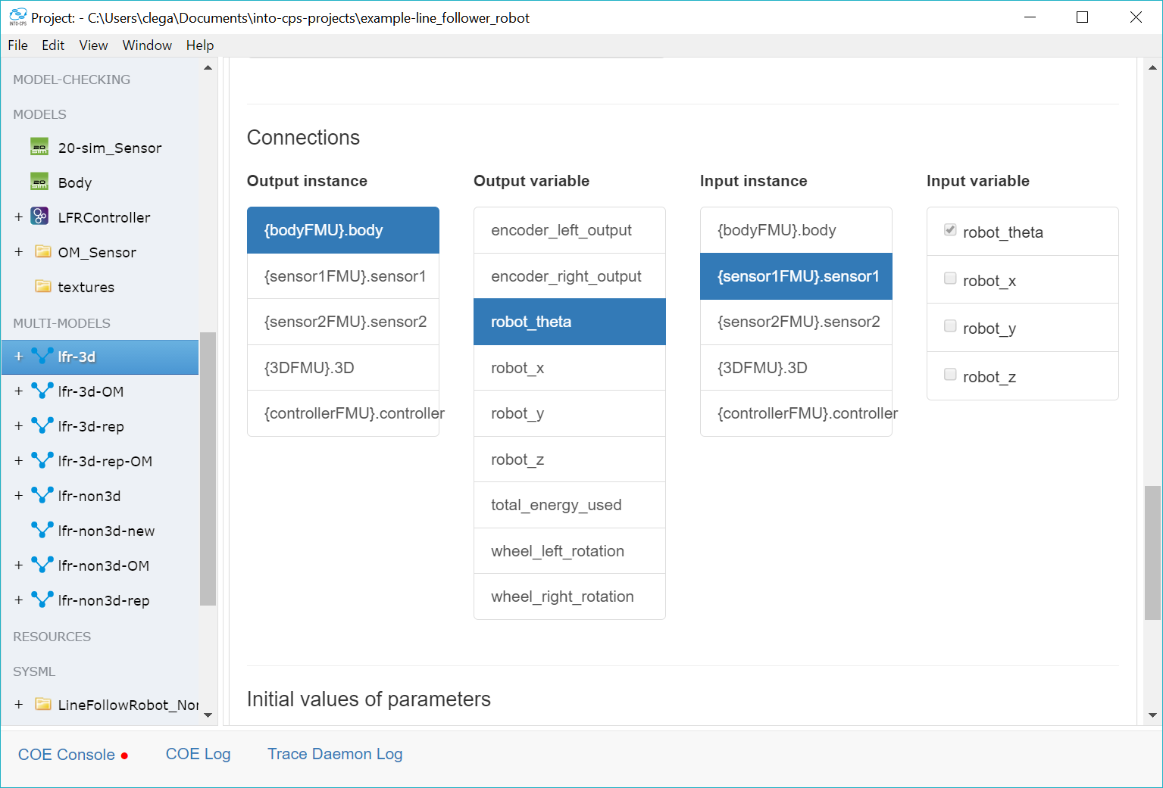
Background – connections inside application
Gets the job done
Limited overview
Find un-connected port?

Slide 5
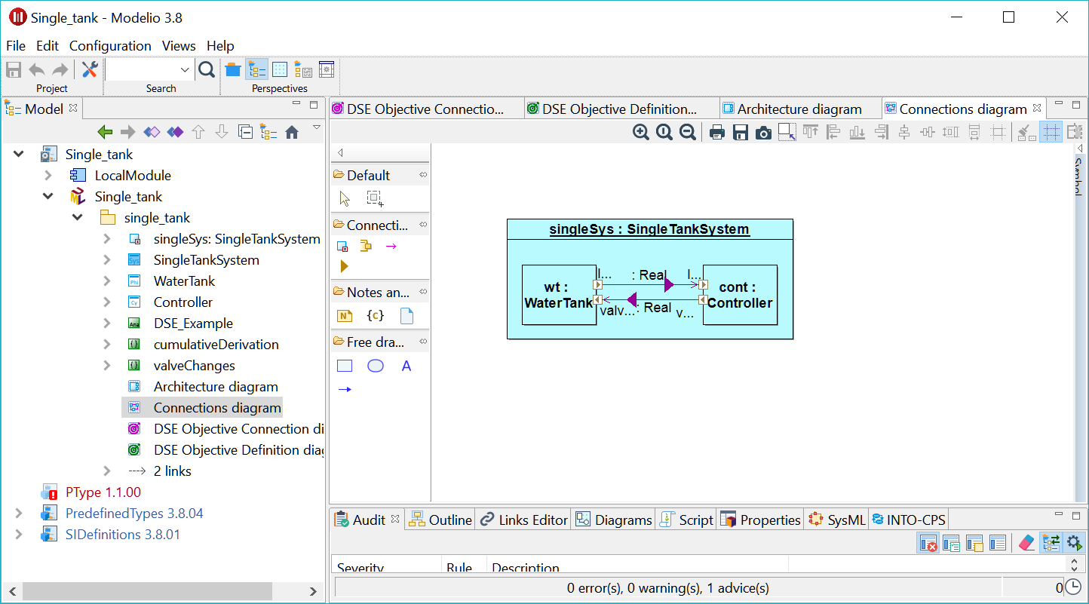
Background – sysML profile
Better overview
Familiar experience
Ease of use?
External

Slide 6
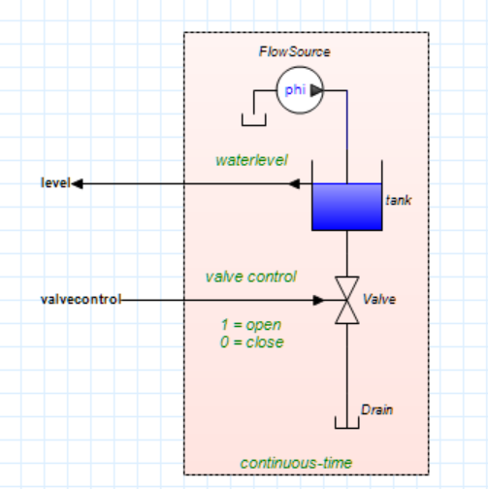
Background – Other tools
20Sim, OMEDIT, Simulink …
Integrated block-based design
Key difference to SysML profile?
Notes:
Consistent with FMU generating tools

Slide 7
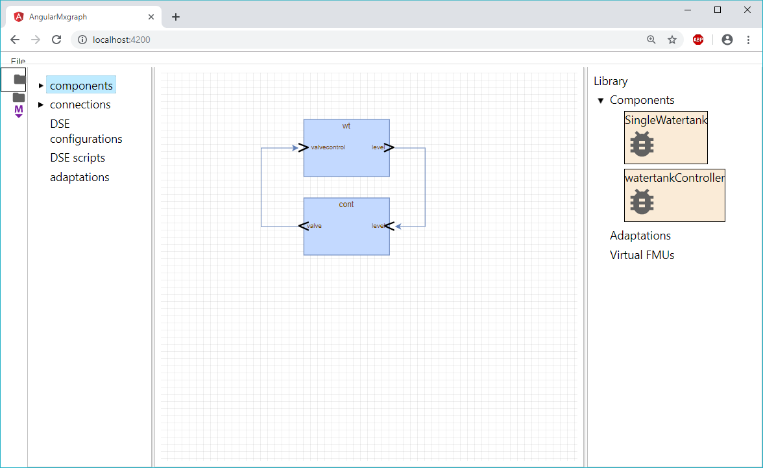
Contribution – Graphical Editor
Integrated Block-based
editor
Faster development loop
User assistance
Future proof

Slide 8
Contribution – Graphical editor
Project explorer
Canvas
Library
Notes:
Leverage familiar experience

Slide 9
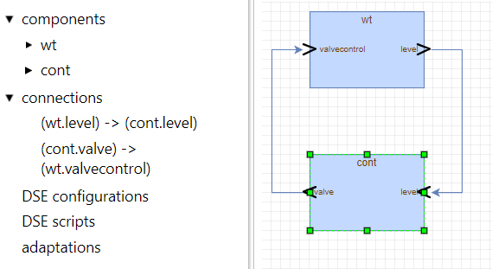
Graphical editor – Project Explorer
Abstract representation of system
Overview of hierarchy
Also shows artefacts not “drawable” on canvas

Slide 10
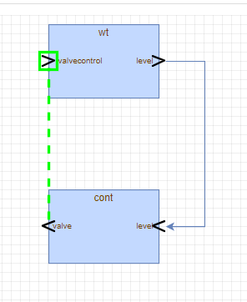
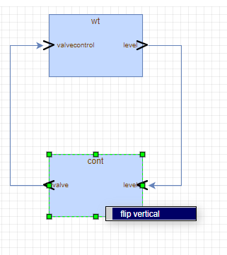
Graphical editor – Canvas
Drag connections
Double click to configure
Context menu

Slide 11
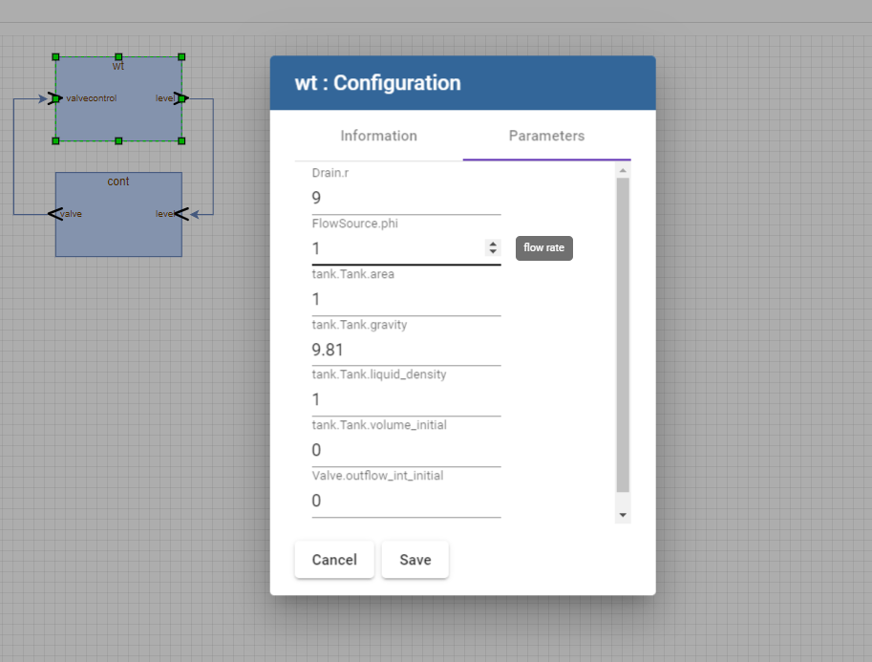
Graphical editor – Parameters
Configuration of system
Instance specific vs shared
Cooping with large number of parameters

Slide 12
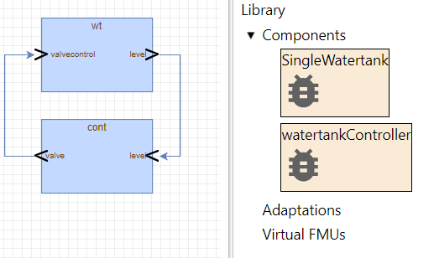
Graphical editor – Library
Drag and Drop
Categories?
Potential sources?

Slide 13
DEMO

Slide 14
Exchange format – Looking forward
Why is this relevant?
Current format
Future format

Slide 15
Exchange format – Current format
Simple JSON format
No geometry, shared parameters, hierarchy …
Requires drilling into the FMU archives

Slide 16
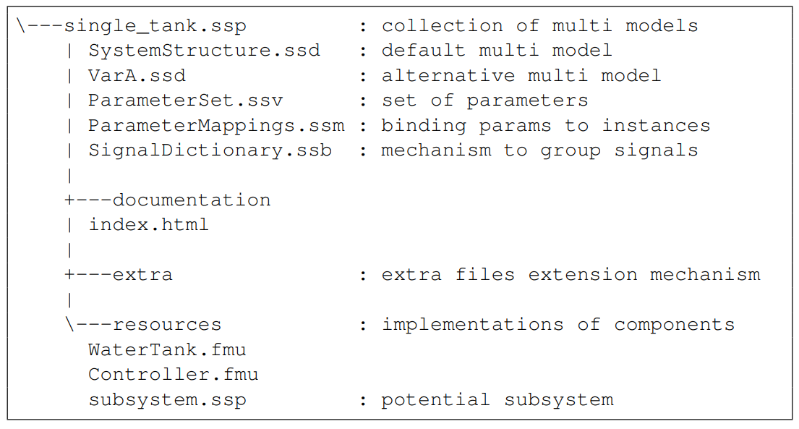
Exchange format – Future
System Structure And Parameterization (SSP)
FMI and SSP
What is an component?
Extension Mechanisms

Slide 17
Future Work
Integration into application(s)
Exchange Format
Adaptations
Hierarchy

Slide 18
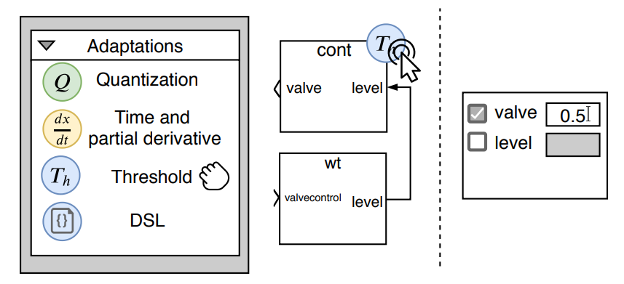
Future Work – Semantic Adaptation
Fix mismatches
Wrapper
DSL vs graphical?

Slide 19
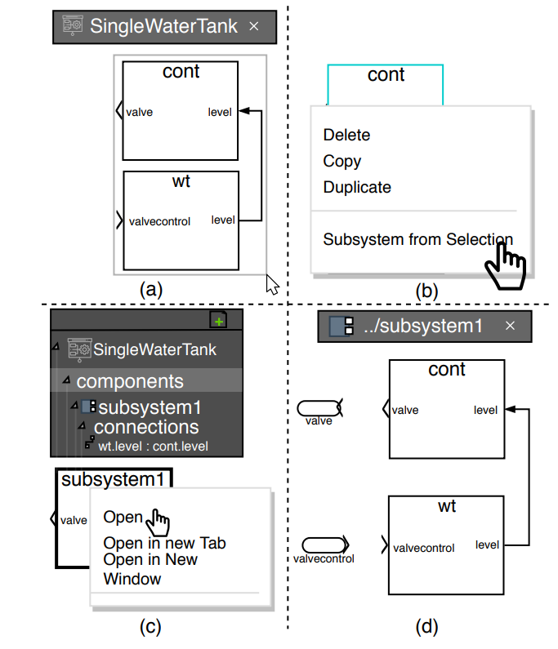
Future Work – Hierarchy
Complexity Reduction
Relation to adaptations
Notes:
SA can be used to achieve this

Slide 20
Acknowledgements
Poul Due Jensen Foundation

